Slide 1
Sitka Sawmill Creek Road
Resurfacing and Pedestrian Improvements
Project # Z681000000

Slide 2
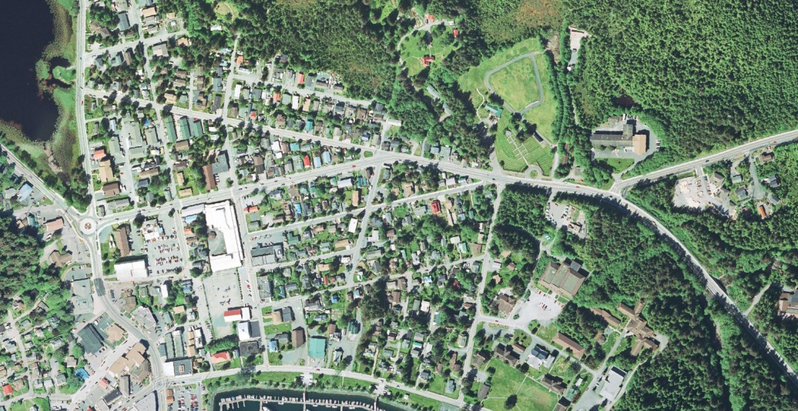
Alaska DOT&PF
Keith Karpstein - Design Group Chief
Loren Gehring - Engineering Manager
Colleen Ivaniszek - Designer

Slide 3
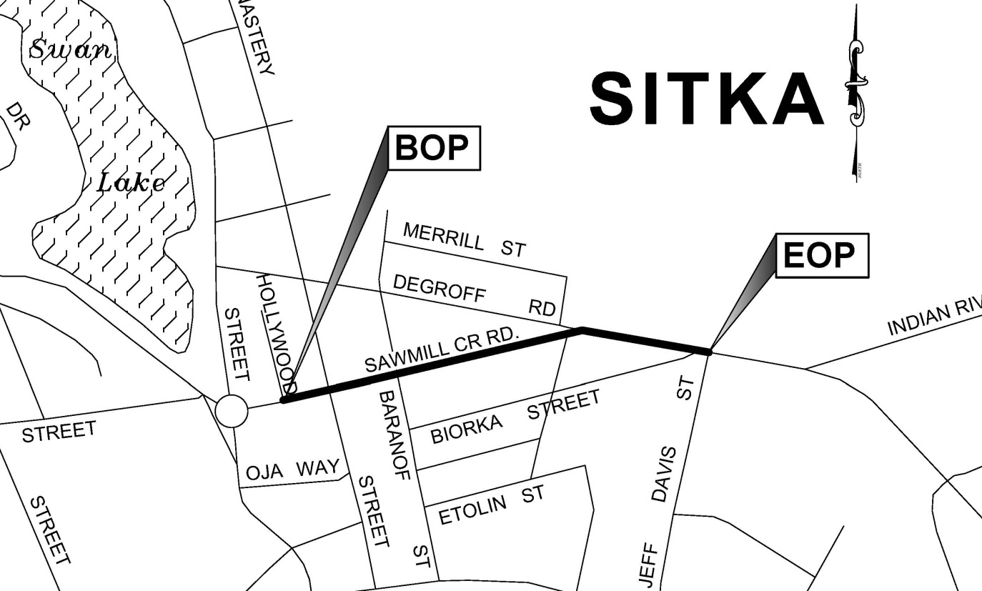
Sawmill Creek Road Project Limits
Begin of Project (BOP) : Hollywood Way
End of Project (EOP) : Jeff Davis Street
Total length of project = 0.40 mile

Slide 4
Sawmill Creek Road Proposed Improvements
Road Improvements
Reconstruct pavement structural section
DeGroff/SMC intersection redesign
New storm drain system
Pedestrian Improvements
ADA compliant sidewalks & curb ramps
Relocate power poles out of sidewalk
Pedestrian Way finder signs
Bicycle Access Improvements
Widened lanes for shared access or dedicated bike lane (depending on alternative selected)
Bicycle pavement markings
Bicycle signs
Bike path realignment at Jeff Davis Street

Slide 5
Option 1 Proposed Typical Section
Work will remain within the limits of the existing ROW
Relocate power poles out of the ROW
13.5’ driving lanes : widened for vehicle & bicycle use
8’ parking lanes would remain on both sides of SMC
ADA upgrades to the sidewalk and curb ramps

Slide 6
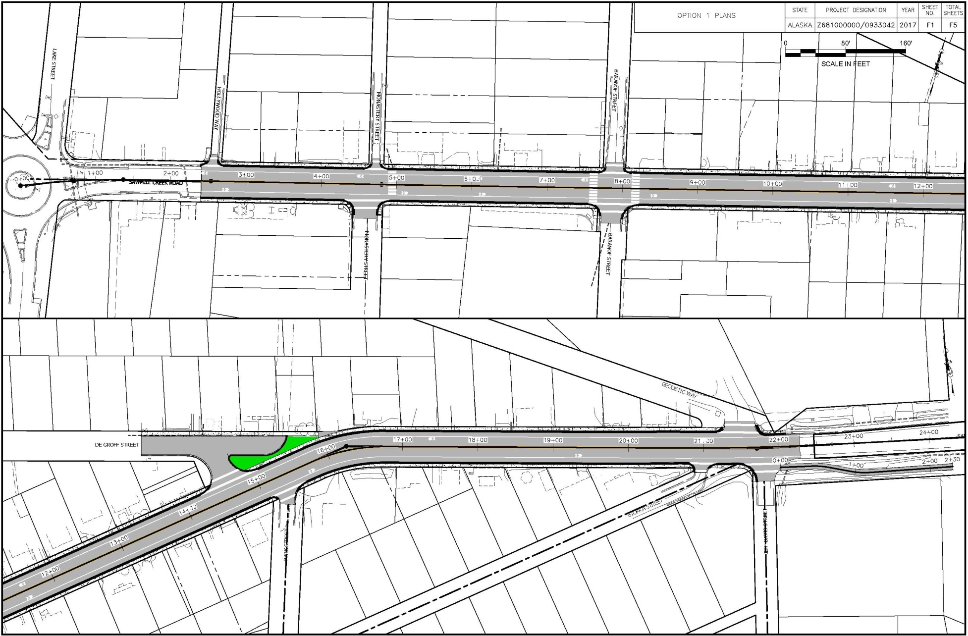
Option 1 Plan View

Slide 7
Option 1 Proposed Signs
Bicycles May Use Full Lane
This sign is used where there are no designated bicycle lanes
Informs drivers that bicycles are likely to occupy the travel lane.
Pedestrians Ahead
Sign would be located inbound on SMC between IRR & Jeff Davis Street

Slide 8
Option 1 Paint Markings
Shared Lane
Pavement Marking
Show bicyclists where they need to be on the road
Alert drivers that bicyclists are likely to occupy the travel lane

Slide 9
Option 2 Proposed Typical Section
Work would remain within the limits of the existing ROW
Relocate power poles out of the ROW
Eliminate parking from the south side of SMC
5’ wide bike lanes on each side of SMC
Driving lane widths would be reduced from 12’ to 11’
Centerline of the road would be realigned
ADA upgrades to the sidewalk and curb ramps

Slide 10
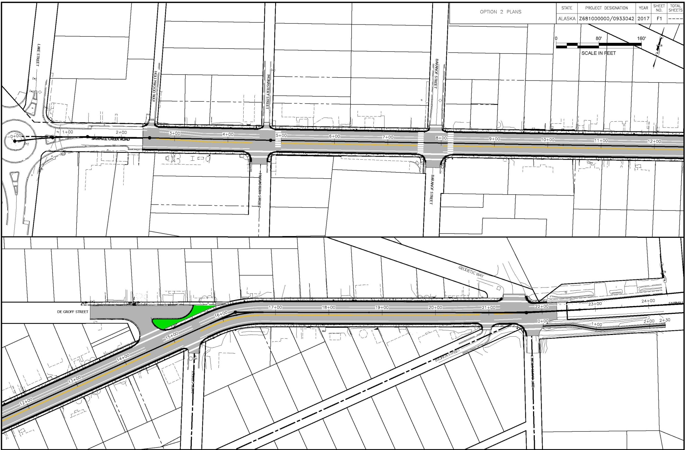
Option 2 Plan View

Slide 11
Option 2 Proposed Signs
Bike Lane Ahead & Bike Lane Ends
Signs would be located at the BOP & EOP of the project.
Bike Lane
Signs would be located throughout the project limits
Pedestrians Ahead
Sign would be located inbound on SMC between IRR & Jeff Davis Street

Slide 12
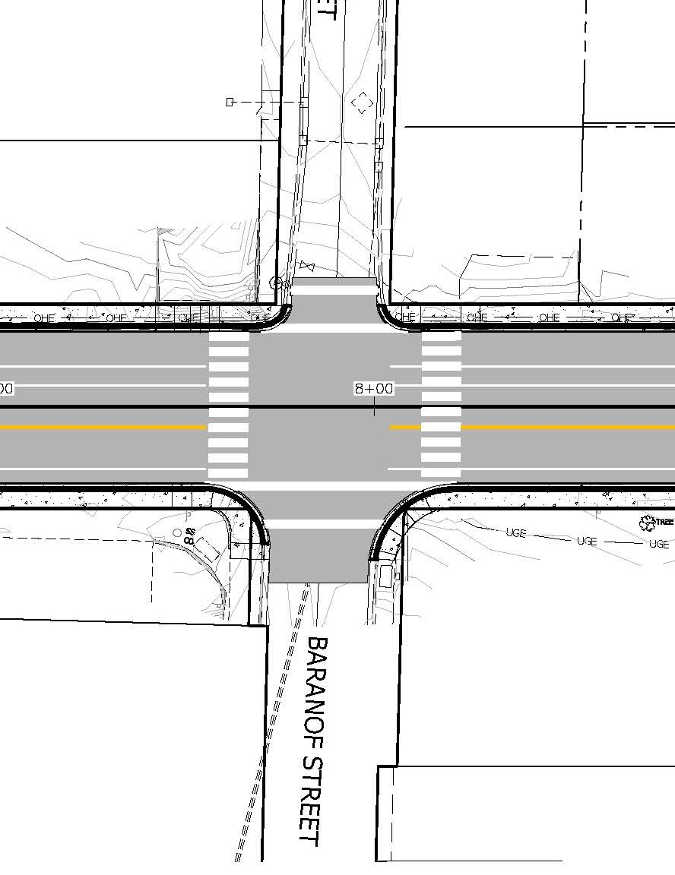
Option 2 Proposed Paint Markings
Bicycle lane markings on each side of SMC (5’ wide)
Crosswalk paint markings (crossing SMC) located at Baranof & Monastery Streets
Crosswalk paint markings (crossing all side streets)
Realigned centerline markings

Slide 13
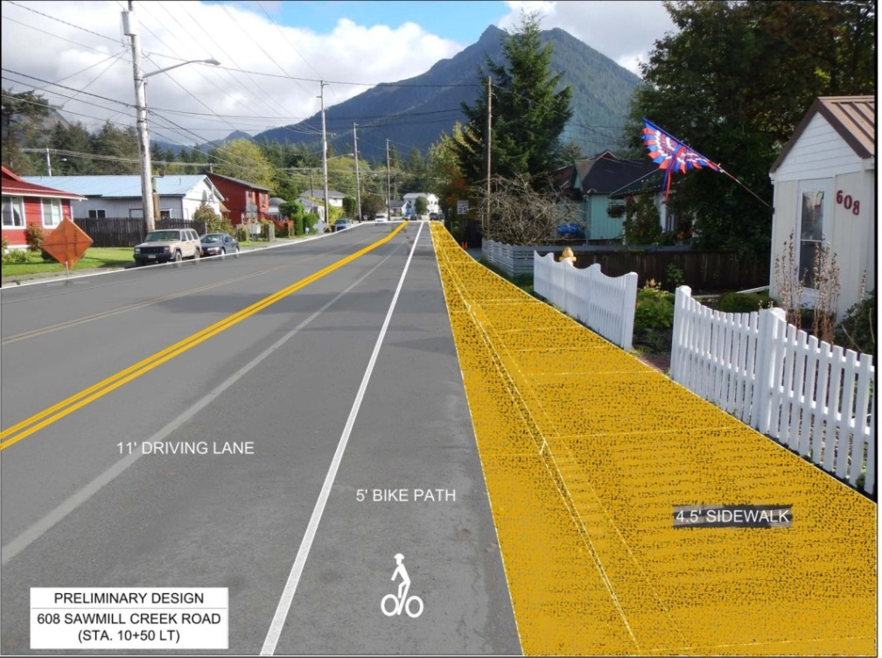
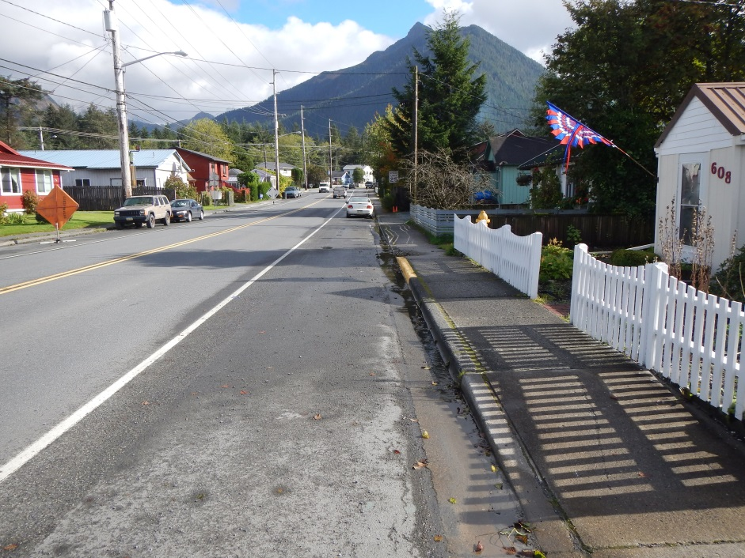
Option 2 - Conceptual photo
Proposed 11’ driving lane, 5’ bike path,
4.5’ sidewalk
Existing driving lane &
parking lane

Slide 14
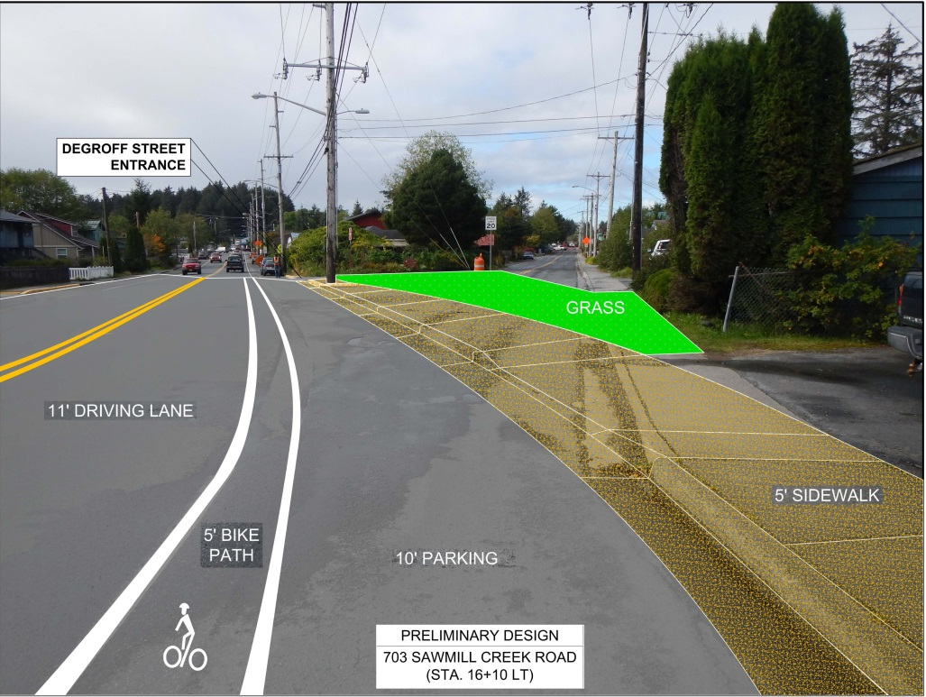
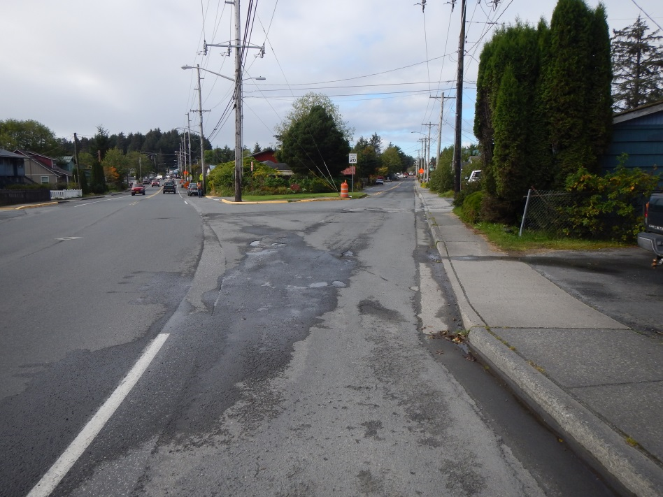
DeGroff Street & SMC Option 2 - Conceptual photo
11’ driving lane, 5’ bike path &
10’ parking
Existing DeGroff/SMC intersection

Slide 15
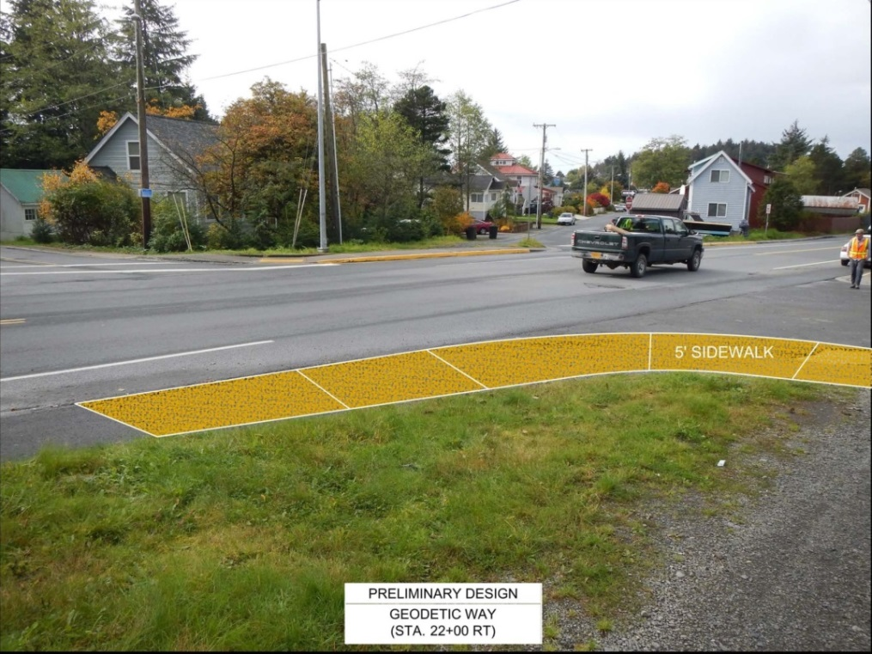
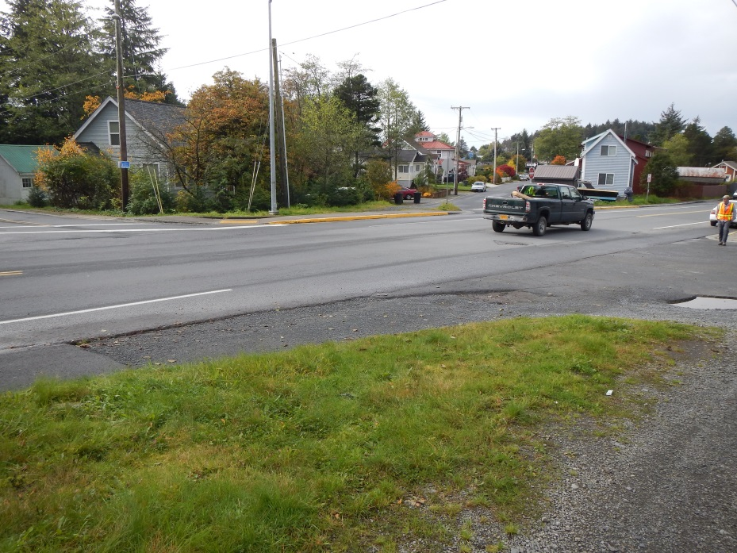
Proposed ADA Sidewalk at Geodetic Way - Conceptual photo
Proposed ADA sidewalk
Existing conditions

Slide 16
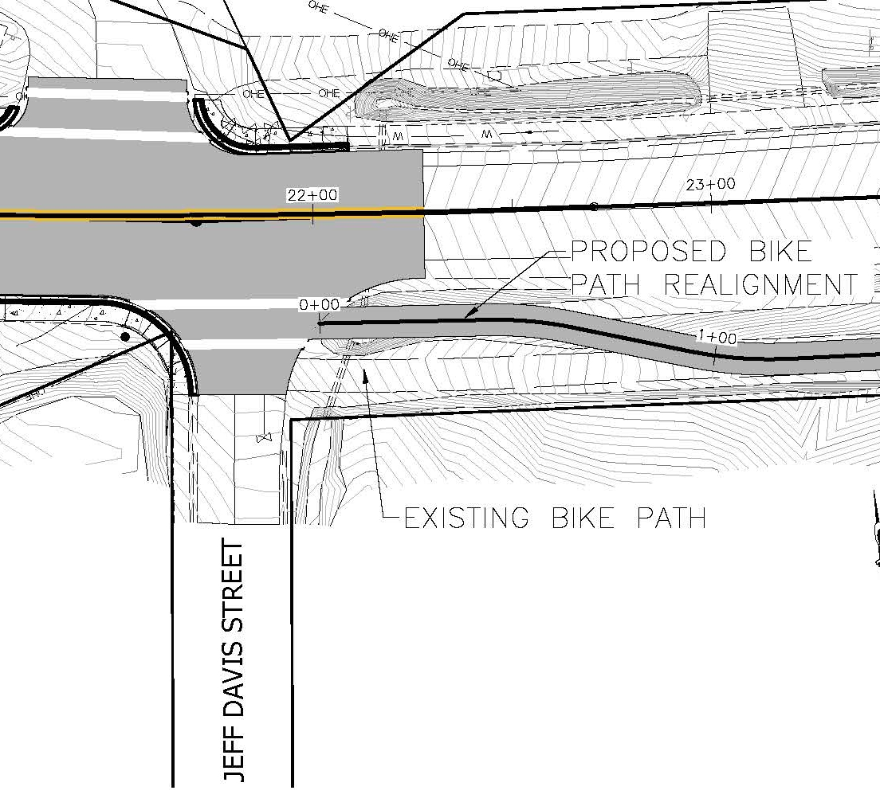
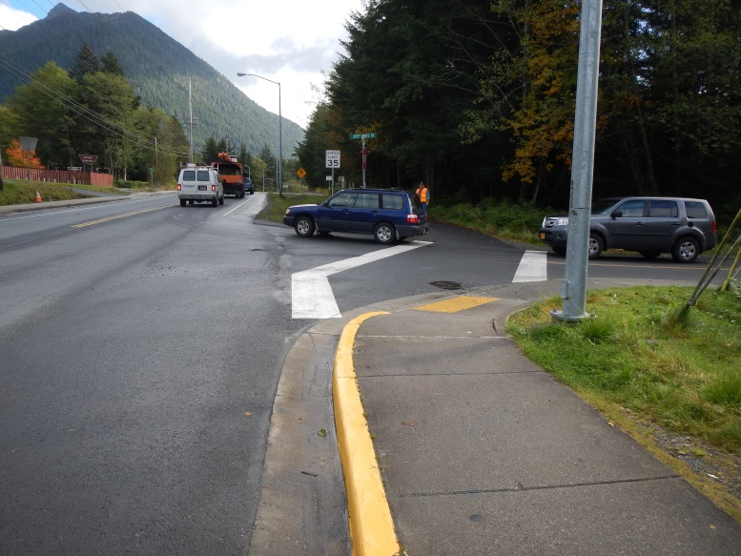
Realignment of the Bike Path at Jeff Davis Street
Existing bike path & crosswalk
Proposed bike path realignment

Slide 17
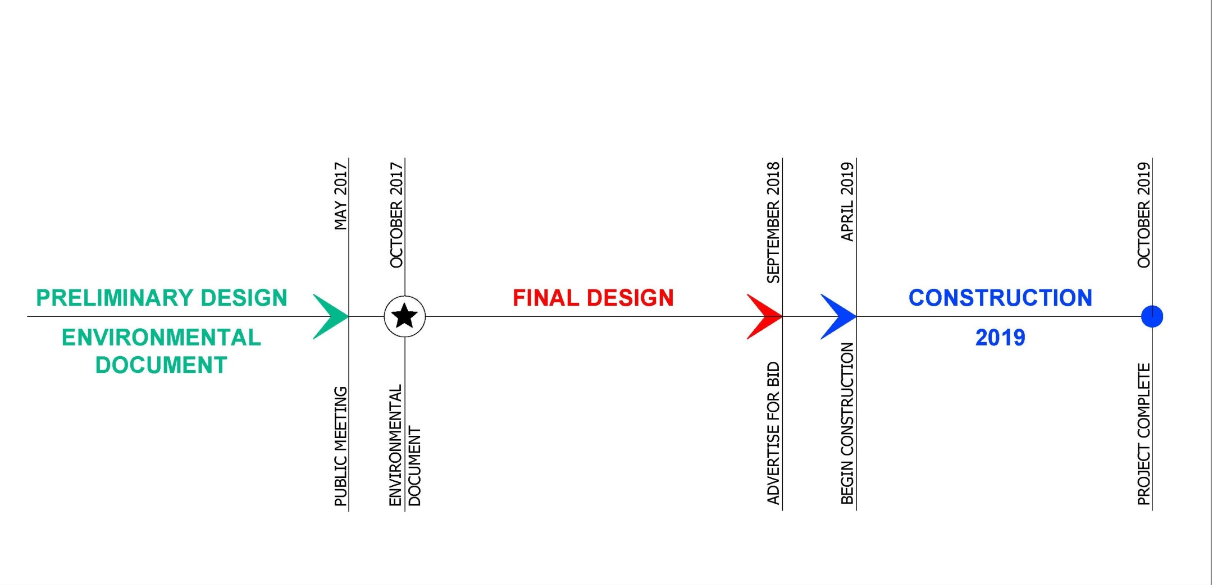
Project Timeline

Slide 18
What’s Next?
DOT & PF is asking the Sitka Assembly to provide DOT with their preferred alternative for the SMC project
Option 1- Proposed Typical Section
Option 2 - Proposed Typical Section

Slide 19
Contact information
Keith.karpstein@alaska.gov 465-1796
Loren.gehring@alaska.gov 465-8189
Colleen.ivaniszek@alaska.gov 465-4436
THANK YOU

