Slide 1
Alaska Department of Transportation & Public Facilities
NEPA Assignment Program Overview
Statewide Environmental Office
October 2017

Slide 2
NEPA Assignment
Overview
What is it?
What will and won’t change?
Organization and authorities
Consultation
Questions and Discussion

Slide 3
NEPA – What is it?
The National Environmental Policy Act (NEPA) requires federal agencies assess environmental effects of actions prior to making decisions.
Using the NEPA process, agencies evaluate environmental, social, & economic effects of their actions. They also provide opportunities for public and agency input.

Slide 4
NEPA Classes of Action
The 3 NEPA “classes of action”
Categorical Exclusion (CE)
Environmental Assessment (EA)
Environmental Impact Statement (EIS)
Since 2009, DOT&PF has had responsibility for CE determinations

Slide 5
NEPA Assignment – What is it?
23 USC 326 Categorical Exclusion Assignment
(CE)
AK since 2009
Looking - AZ
23 USC 327
Full NEPA assignment (CE, EA, EIS)
CA, TX, OH, FL, UT
Looking - NE

Slide 6
NEPA Assignment – What is it?
Formal Assignment of FHWA’s NEPA responsibilities to a State who would assume:
All NEPA classes of action: CEs, EAs and EISs
All environmental laws, rules and orders
Under this program, DOT&PF will be deemed to be a Federal Agency on most Federal-aid Highway Program projects for environmental matters.

Slide 7
NEPA Assignment – What is it?
DOT&PF assumes legal responsibility and liability to ensure compliance with all environmental requirements
DOT&PF assumes liability and agrees to be sued in Federal court
Memorandum of Understanding (MOU) defines the range of project actions and environmental responsibilities the State assumes

Slide 8
Exclusions from MOU
Projects that are not designed and constructed by DOT&PF
Direct recipient FAHP projects;
Recreational Trails
TIGER Grants
Tribal projects
Shakwak
FASTLANES
Interstate access approvals, except for DOT&PF projects
Specific EIS* projects:
Gravina Access
Juneau Access
Sterling Highway MP 45-60
*The DOT&PF will be responsible for any additional environmental review after the expiration of the statute of limitations (23 U.S.C. 139(l)).

Slide 9
NEPA Assignment – What is it?
By law, FHWA retains:
Government to Government Tribal consultation
Federal-aid eligibility & other project decisions
Projects that cross state lines; or are adjacent to, or that cross, international boundaries
Project level air quality conformity determinations

Slide 10
NEPA Assignment – What is it?
DOT&PF’s requirement to comply with all environmental laws, regulations, and policies remains the same
Potential for faster project delivery comes from:
Eliminating FHWA review and approval steps
Increased environmental process innovation
Easier communication and consultation

Slide 11
How will this impact DOT&PF?
DOT&PF must comply with MOU in assuming FHWA’s environmental responsibilities:
Maintain detailed files, records and make them available to FHWA
Conduct regular self assessments
Maintain professional and experienced staff
Report all NEPA decisions to FHWA

Slide 12
How will this impact FHWA?
FHWA retains oversight responsibilities, and will provide:
Training
Program Technical assistance and policy interpretation
But no project-specific assistance
Audits of DOT&PF processing and decision making
Process and Program reviews
Reports back to Congress

Slide 13
Communications with FHWA
Any Tribe, state or Federal agency may contact FHWA at any time for:
Concern with how DOT&PF is fulfilling assigned environmental responsibilities
Additional information about NEPA Assignment program
Other project-specific matters

Slide 14
FHWA Audits
Once a year for 4 years
FHWA may invite any state or Federal agency to participate in audit of DOT&PF’s Program
Audits may include interviews with agency staff
Results of audit published in Federal Register
First audit will be April 2018

Slide 15
Alaska DOT&PF’s Commitment
Under NEPA Assignment, Alaska DOT&PF will remain committed to:
Listening to the public, Tribes, and agencies early and throughout the environmental process
Responding quickly to concerns to find solutions together
Maintaining the integrity of the NEPA process and compliance with environmental laws

Slide 16
Agency Consultation with DOT&PF
Day-to-day & Informal
Consultation
Regional DOT&PF Environmental and Engineering Staff interact with resource agencies
Scoping
Project Design Considerations
Permitting
Formal Consultation
DOT&PF NEPA Program Manger acts as Federal Agency representative, involved in:
Letters
Consultations
“Wears the FHWA hat”
Ex: Section 7 of Endangered Species Act; MMPA IHA

Slide 17
Approval Authorities
EIS - Statewide Environmental Program Manager
EA - Statewide Environmental Program Manager
- (delegated) NEPA Program Manager
CE - NEPA Program Manager
PCE - Regional Environmental Manager

Slide 18
NEPA Assignment at DOT&PF Statewide Environmental Office
Statewide
Environmental Program Manager
NEPA Assignment Program Mgr
NEPA Program Manager
NEPA Program Manager
Cultural Resource Program Mgr
Environmental Compliance Program Mgr
NEPA Program Manager
NEPA Program Manager
Cultural Resource Specialist
Stormwater Specialist
NEPA Program Manager
18

Slide 19
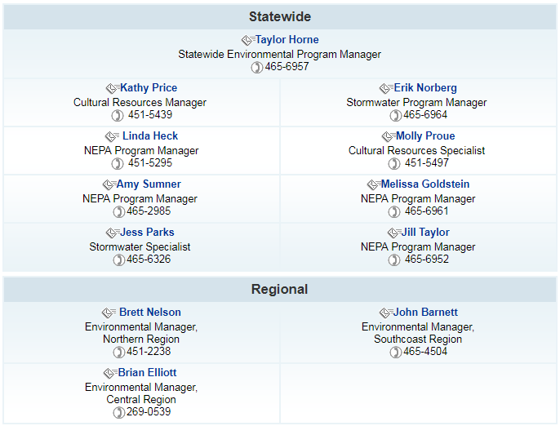
NEPA Assignment at DOT&PF Environmental Staff
19

