Slide 1
Development of Innovative Antifreeze Grout Mortar for Anchor Application in Cold Regions
Jenny Liu, Ph.D., P.E.
Chuang Lin
Xiong Zhang, Ph.D., P.E.
University of Alaska Fairbanks
November 24, 2014
2014 Alaska Concrete Summit Meeting

Slide 2
Outline
Introduction
Laboratory development of antifreeze grout mortar
Field performance verification
Summary

Slide 3
Introduction
Grouted anchors are widely used in unfrozen soil due to cost and time efficiency.
Unique challenges when used in Alaska and other cold regions
Elongated curing time due to low temperature and reduced or even no strength of the grout
Potential thawing of the warm permafrost due to hydration heat which might undermine anchor capacity

Slide 4
Research Objective
To develop an innovative grout mortar:
depressing the freezing point of the mix water available for the hydration process
accelerating the early-age strength gain at low temperature
enhancing excellent flowability for grouting

Slide 5
Development of Antifreeze Grout Mortar
Materials
type I/II cement
sand
water
chemical admixtures
Accelerator (A)
Corrosion inhibitor with slight acceleration properties (B)
Mid-range water reducer (C)
High -range water reducer (D)

Slide 6
Development of Antifreeze Grout Mortar
Lab tests
flow test
ASTM 230 and ASTM C1437
compressive strength
1 or 3-day, 7 or 28-day
ASTM C109
temperature monitoring
ASTM C1622
Notes:
ASTM 230 Standard Specification for Flow Table for Use in Tests of Hydraulic Cement
ASTM C1437 Standard Test Method for Flow of Hydraulic Cement Mortar
ASTM C39 Compressive Strength of Cylindrical Concrete Specimens
ASTM C1622 Standard Specification for Cold-Weather Admixture Systems

Slide 7
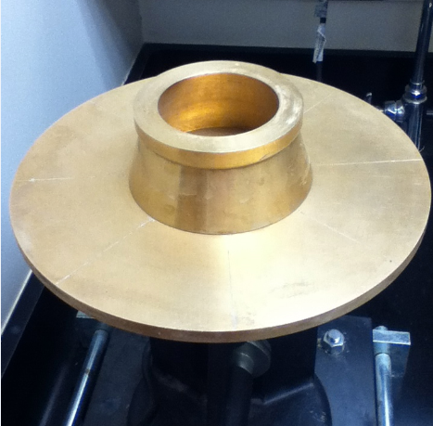
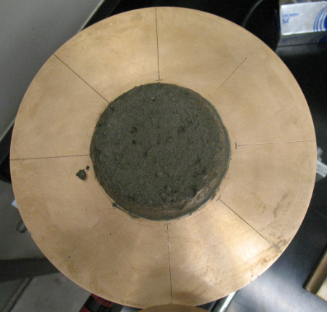
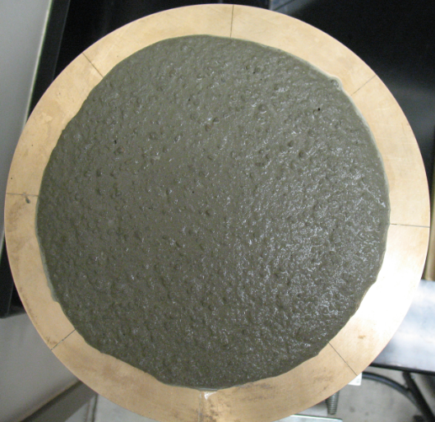
Flow Test
Flowability Test Equipment
Sample before Test
Sample after Test

Slide 8
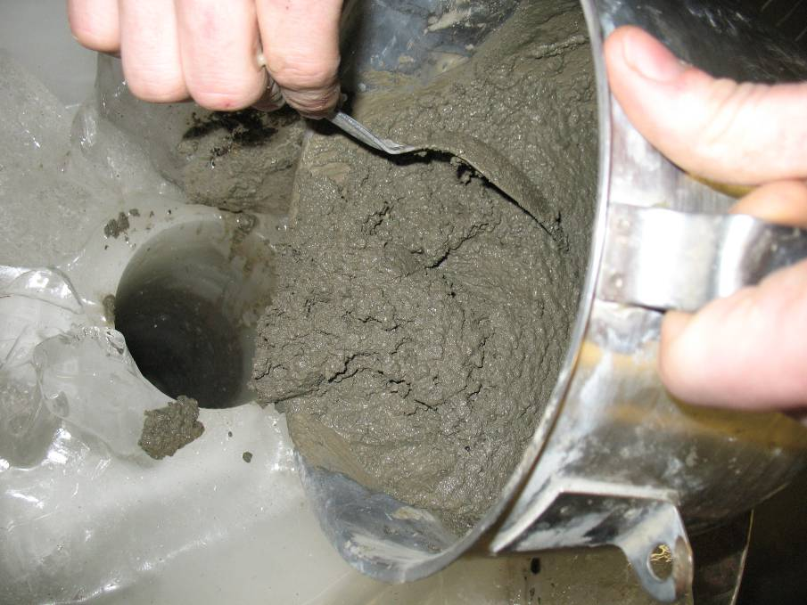
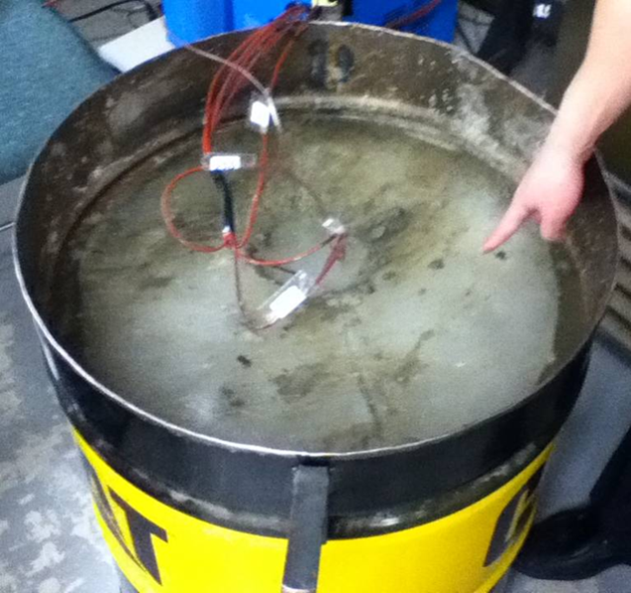
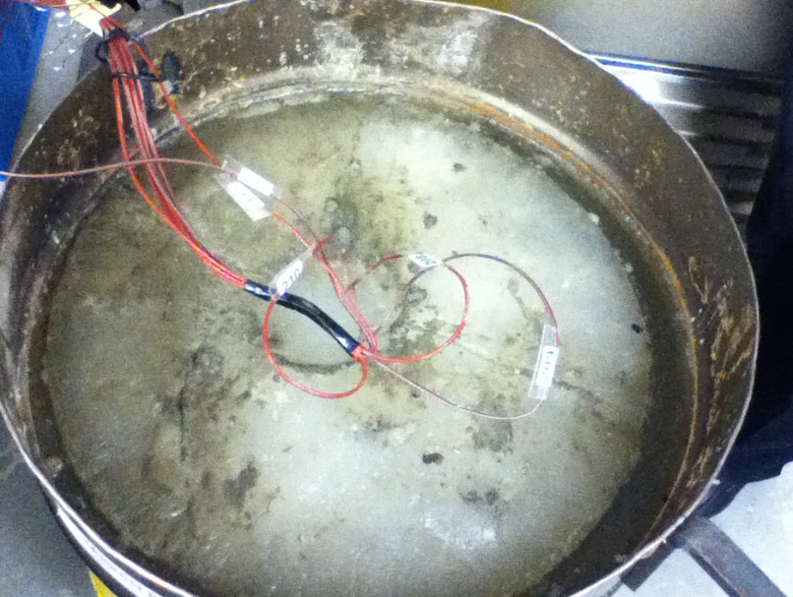
Temperature Monitoring

Slide 9
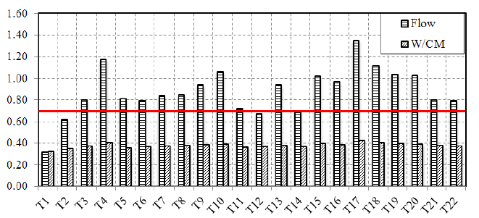
Flow Results

Slide 10
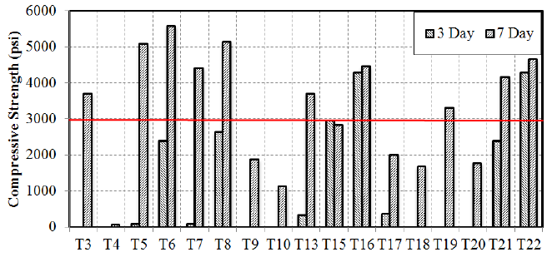
Early-age Strength
Notes:
Definition:

Slide 11
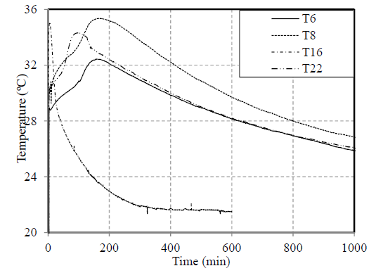
Mortar Temperature (specimens in room temperature environment)

Slide 12
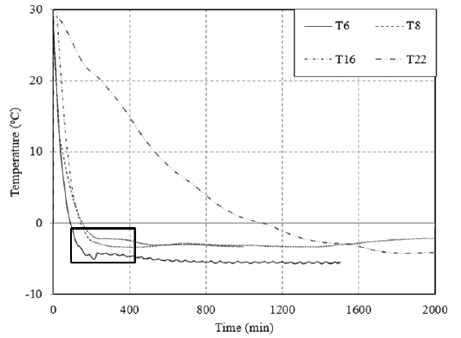
Mortar Temperature (specimens in subfreezing temperature environment)
Notes:
Definition
Freezing point: temperature at which the water in the mixture is supercooled, meaning that its temperature is colder than that required for ice to melt.
Typical freezing curves for normal and antifreeze concrete specimens
are shown in Fig. 3. The temperature at which the initial
freezing point occurs is indicated where the slope of the curve flattens.
At this temperature, the water in the mixture is supercooled,
meaning that its temperature is colder than that required for ice to
melt. This is followed by a slight increase in temperature due to the latent heat of fusion from the formation of ice crystals (Alexiades
and Solomon 1993).

Slide 13
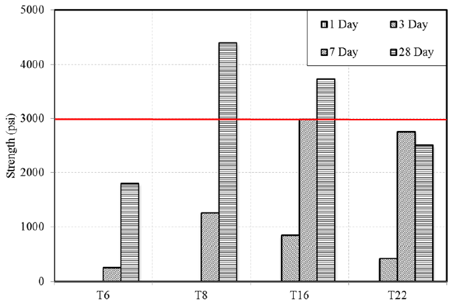
Compressive Strength (specimens cured at -5ºC)

Slide 14
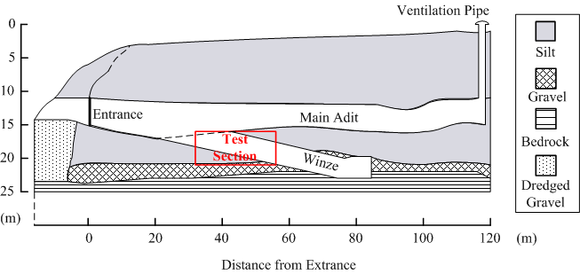
Test Site Description
Schematic Plot of the CRREL Permafrost Tunnel
Notes:
Test Site Description:
Cold Region Research and Engineering Laboratory (CRREL) Permafrost Tunnel, located at Fox, AK, which is 16 miles north of Fairbanks;
According to CRREL guidebook, it is 110 m in length, 2-2.5 m in height and 4 to 5 m in width. Tunnel composed of two parts: one is nearly horizontal adit, the other is an inclined (average 14°n) adit which denoted as “winze”.
3.

Slide 15
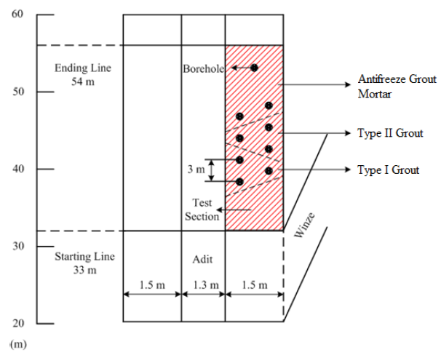
Test Section
Notes:
Test Section Description:
Selected in the right side of the main adit, ranging from 33 m to 54 m.
Test section divided into three sub-sections and grouted with three different grouting materials. Detailed info. for grouting materials in slide

Slide 16
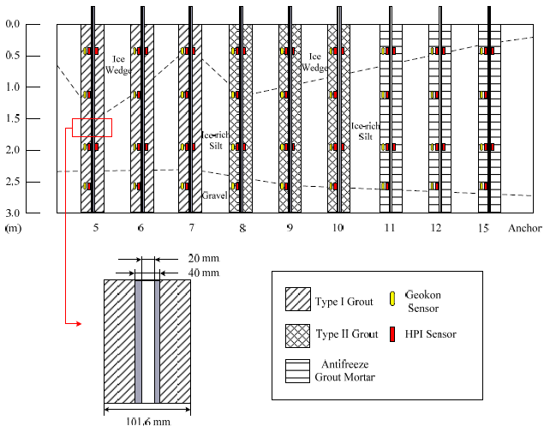
Soil Profile and Anchor Configuration
Notes:
Soil Profile:
Ice-rich silt: average water content=94%, dry density=704.9 kg/m^3,
Based on drilling log, depth of ice wedge= 0.3 m - 1.5 m, average gravel layer=0.6 m
Tested soil sample: water content= 82.1%, organic content <5%, PL and LL= 34 and 38, defined as ML according to USCS.
2. Anchor Configuration:
Dimension: anchor tendon inner and outer diameter= 20 mm and 40 mm, diameter of grout= 101.6 mm, length = 3 m.
3. Sensors Info.:
HPI weldable strain gage: measure the strain in anchor tendon;
Geokon vibrating wire strain gage: measure the strain in grout and anchor temperature;
Sensor Locations: from top to bottom, 0.46 m, 1.17 m, 1.88 m, 2.59 m. HPIs were welded on both sides at 0.46 m and 1.88 m as an indication of loading eccentricity.

Slide 17
Grouting Materials
Type I anchor grout:
unsanded, portland cement-based, expanding grout with silica fume, fly ash and other selective additives
comparable to high alumina based grouts and recommended W/CM is 0.27, designed for cold weather conditions
Type II anchor grout:
Non-shrink, thermally-conductive grout
recommended W/CM is 1 and preheat water to 32ºC before mixing
Antifreeze grout mortar
T16

Slide 18
Field Performance Verification
Temperature monitoring
evaluate the thermal disturbance of the surrounding permafrost
Creep test
analyze the load redistribution process
Pullout test
determine the ultimate capacity

Slide 19
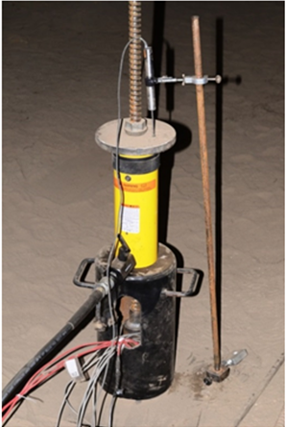
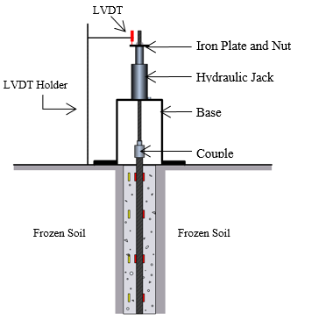
Load Test Setup
Notes:
Loading system components:
One Enerpack Hydraulic Jack (155 mm in height, outer and inner diameter= 114 mm and 33 mm), base, iron plate and nut, couple (connect tested anchor with loading system), LVDT and holder, Campbell CR1000 datalogger.

Slide 20
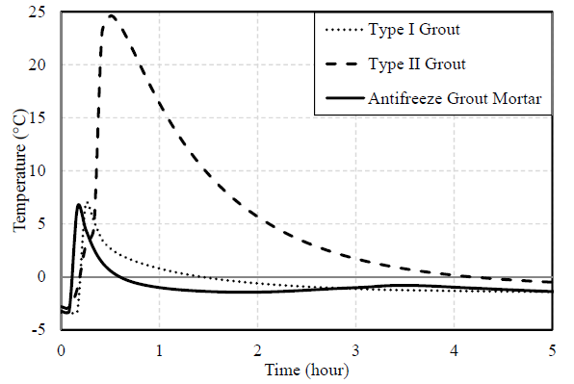
Field Test Results
Temperature vs. Time for Different Grouting Materials (5 hrs)
Notes:
Maximum temp. and time lag for temp. above 0ºC serves as indicators of the permafrost degradation degree.
Sensor located at 1.17 m from the bottom, mitigate the influence of the ambient environment.
Max. temp.: Microsil= 6.9ºC , Bentonite= 24.6ºC, Antifreeze= 6.5ºC
temperature increment: Microsil=10.2ºC , Bentonite= 27.5ºC , Antifreeze= 9.7ºC
Time lag for temp. above 0ºC : Microsil= 1hr, Bentonite=4hr, Antifreeze= 0.5 hr
4. Conclusion: Antifreeze shows lowest degree of permafrost degradation for short – term

Slide 21
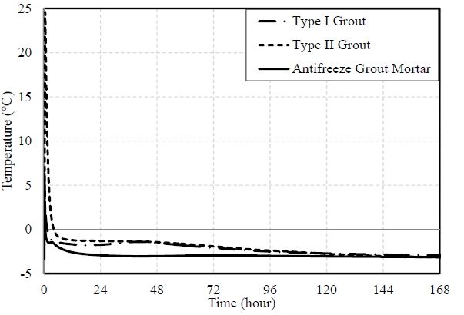
Field Test Results
Temperature vs. Time for Different Grouting Materials (5 days)
Notes:
Evaluate the effect of hydration heat and time lag for temp. to drop back to initial temp. (temp. before grouting).
temp. increment induced by hydration heat: Microsil= 0.5ºC, Bentonite=NA(no hydration heat), Antifreeze= 0.5ºC.
Time lag: Microsil= 5.5 days, Bentonite= 5.5 days, Antifreeze= 1.4 days.
Conclusion: Antifreeze has the lowest effect on the degree of permafrost degradation for long – term.

Slide 22
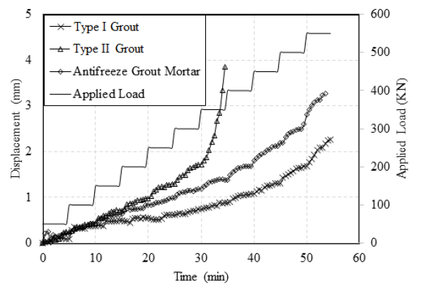
Field Test Results
Notes:
Apply load with 50 KN increment and 5 min per load level. Curves have been revised by subtracting the displacement induced by the settlement of the loading system;
Only Bentonite anchors were pulled out at 350 KN, Microsil and Antifreeze did not pullout at 550 KN. Maybe the loading time is too short, short – term strength is larger than long – term strength;
Total displacement: Microsil= 2.26 mm; Bentonite= 3.85 mm; Antifreeze= 3.22 mm
Even though total disp. for Antifreeze is larger than that for Microsil, the ave. disp. rate are at the same magnitude: Microsil= 0.045 mm/min; Antifreeze= 0.061 mm/min. Disp. rate for Bentonite before 350 KN= 0.055 mm/min.

Slide 23
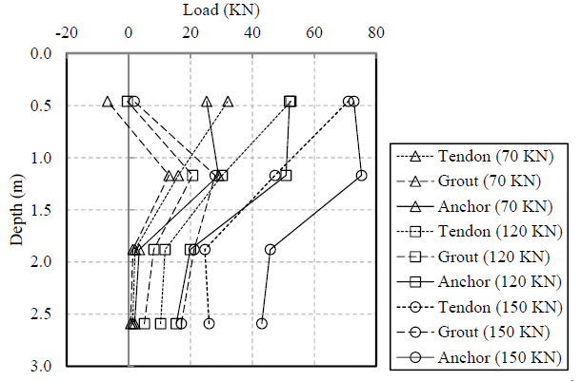
Field Test Results
Anchor 5 (Type I grout)
Notes:
Graph Description:
dot lines: load in tendon; dash lines: load in grout; solid lines: load in anchor.
negative value: tensile strength; positive value: compressive strength.
Also, tensile strength in the grout is an indication of cracks.
Analysis:
Crack observed at 70 KN at location of 0.5 m; load only transfers to a depth of 1.22 m at 70 KN;
During the whole loading process, the middle part of the anchor (0.5 m to 1.8 m) bares most of the applied load.

Slide 24
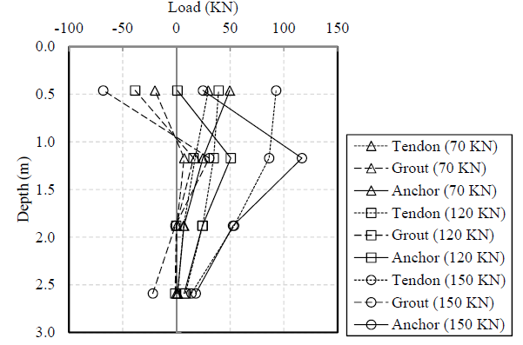
Field Test Results
Anchor 8 (Type II grout)
Notes:
Crack observed at two locations (0.91 m and 1.83 m) at 70 KN which indicates that Bentonite clay shows more brittle properties than Microsil.
Comparative to Microsil, most of the applied load was sustained by the middle part of the anchor (0.61 m to 1.83 m).

Slide 25
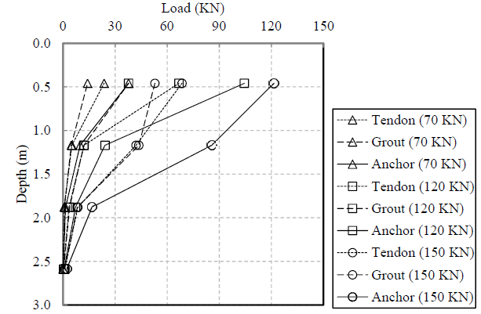
Field Test Results
Anchor 11 (antifreeze grout mortar)
Notes:
No crack was observed during the whole loading process indicating it gives the highest tensile strength.
At 70 KN, load only transfers to a depth of 1.22 m and at 120 KN, load transfers to a depth of 1.9 m, most of the load was bared by the upper part of the anchor (0 m to 1.2 m). Even at 150 KN, load only transfers to 2.6 m, which means there is still some potential for the anchor to bear larger load level.
Conclusion: Antifreeze shows the best load performance among all 3 grouting materials: highest tensile strength, has the potential to bear larger load.

Slide 26
Summary
Developed an innovative antifreeze grout mortar
applicable to cold regions
depresses the freezing point of the mixing water
gains high early-age strength and excellent flowability
Better performance compared with other products
lowest thermal disturbance
uniform load distribution and no crack observed

Slide 27
What’s Going on at UAF
ASCE Concrete Canoe Competition
International Symposium on Systematic Approaches to Environmental Sustainability in Transportation, August 2-5, 2015, Fairbanks
http://cem.uaf.edu/cesticc/symposium.aspx

Slide 28
Contact
Dr. Jenny Liu
Center for Environmentally Sustainable Transportation in Cold Climates (CESTiCC) Ine.uaf.edu/cesticc
Dept. of Civil and Environmental Engineering
University of Alaska Fairbanks
907-474-5764
jliu6@alaska.edu
Notes:
28

